Slide 1







SpaceX Landing prediction
Hiro Naito
Dec 12th, 2023
Presented to: Space Y leadership team

Slide 2



OUTLINE
Executive Summary
Introduction
Methodology
Results
Visualization – Charts
Dashboard
Discussion
Findings & Implications
Conclusion
Appendix

Slide 3

EXECUTIVE SUMMARY
To win over customers when bidding against Space X, we want competitive pricing
SpaceX's bid price depends heavily on if they can reuse the rocket for its launch (for another future launch)
Therefore if we can predict their bidding launch's reuse chances, we can get better pricing guess (assuming SpaceX does similar pricing strategy)
Goal is to answer the question is, "Would SpaceX's new (bidding) launch reuse stage 1 or not?"
Our best Machine Learning classifier had average accuracy of 83%, which seems usable
We can likely improve if we have more data points

Slide 4

INTRODUCTION
We want more customers. SpaceX is our competitor and we need to have competitive advantage.
One way to compete is cost
If we can estimate SpaceX's bidding price, we can bid for lower price (and win customers)
Space X's cost of launch heavily depends on reuse success of stage 1 rocket
If it can be reused, SpaceX can cut the cost (and therefore the bid price) to ~half
If we can predict SpaceX's chances of reuse success, then we have better idea of what their bidding price will be.
Therefore, the goal is to answer, "Would SpaceX's new (bidding) launch reuse stage 1 or not?"
Approach is to use Machine Learning (ML) classifier)

Slide 5

METHODOLOGY
Collecting data
Use SpaceX public data & API to collect launch information
Data wrangling
Fix problematic values (e.g. nulls)
Use one hot encoding for binary data (as ML feature)
Data analysis
Use SQL for (aggregated) quantitative analysis of data
Use visualizations to look for trends & correlations with successful reuse launch
Create dashboard for others to explore data
Building & evaluating ML classifier
Test few ML classifiers to predict if a particular launch (or bid) can land 1st stage successfully or not
Each classifier will be tested with multiple parameters
Accuracy will be used as eval score

Slide 6
RESULTS – Data collection
Used following SpaceX API endpoints for data collection:
https://api.spacexdata.com/v4/launches/past
https://api.spacexdata.com/v4/rockets/
https://api.spacexdata.com/v4/launchpads/
https://api.spacexdata.com/v4/payloads/
https://api.spacexdata.com/v4/cores/
Also pulled data from wikipedia
https://en.wikipedia.org/wiki/List_of_Falcon_9_and_Falcon_Heavy_launches

Slide 7
RESULTS – Data wrangling
Replaced empty 'payload mass' field with average of all
Created new outcome label for reuse based on landing class field (which is a combination of landing success and where the landing was done/attempted)
Used one-hot encoding for a few fields
'Orbit','LaunchSite','LandingPad','Serial'

Slide 8
RESULTS - Analysis
Data source Basic stats
# of launches:
2010 ~ 2020
Overall success rate:
Launch attributes:
Examples: Launch site, Payload mass, Landing pad

Slide 9
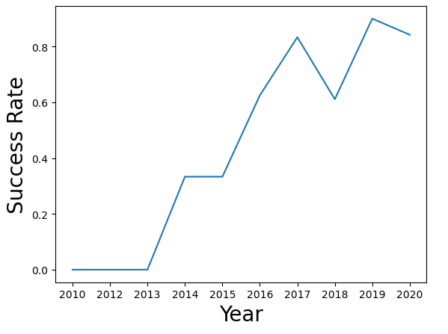
RESULTS - Analysis
The reuse success rate has been increasing year over year
Implication: We should expect the trend of high success rate to continue

Slide 10
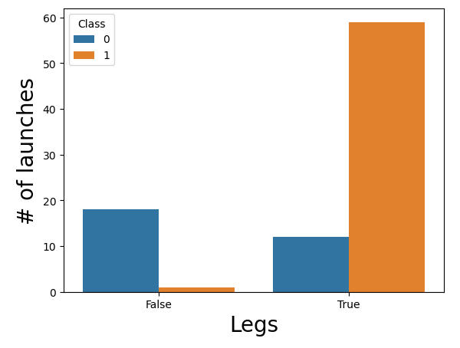
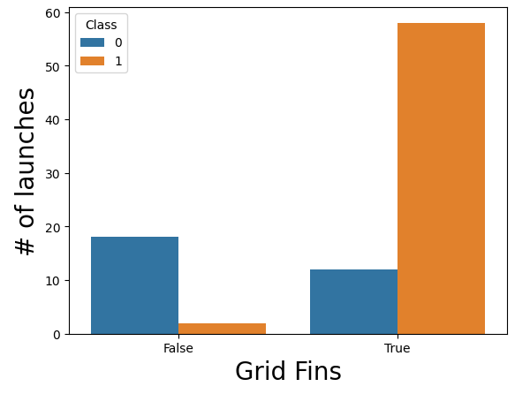
RESULTS - Analysis
Having Legs or Grid Fins seems to signal success rate

Slide 11
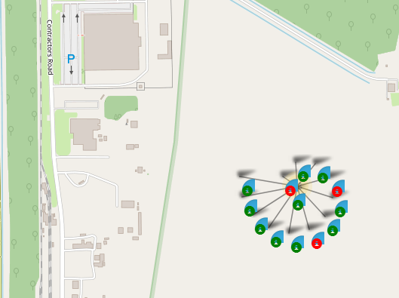
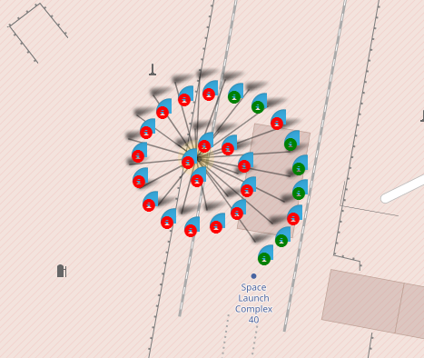
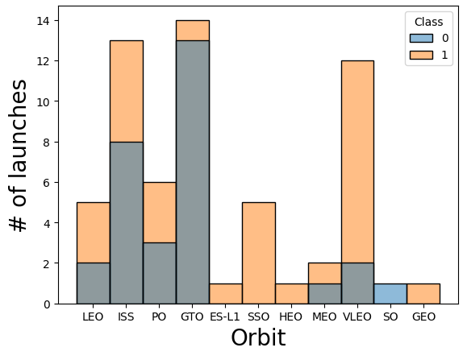
RESULTS - Analysis
Some launch site and orbit types shows noticeable difference in reuse success rate
Launch site (green = reused)
Orbit type (1 = reused)
Note: VLEO is a relatively new site

Slide 12

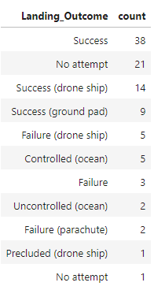
RESULTS - (SQL) Analysis
First reuse success was in 2015
A lot of launches ended as no attempt

Slide 13

RESULTS: DASHBOARD

Slide 14
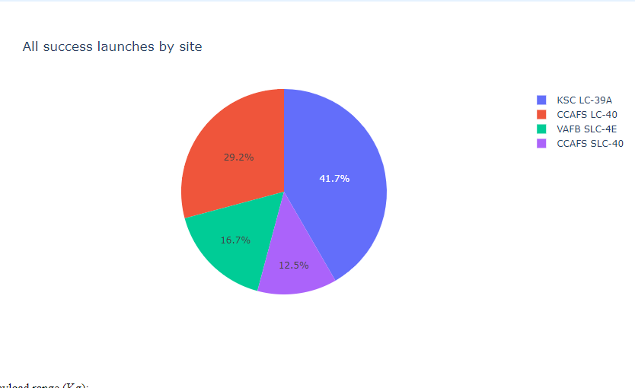
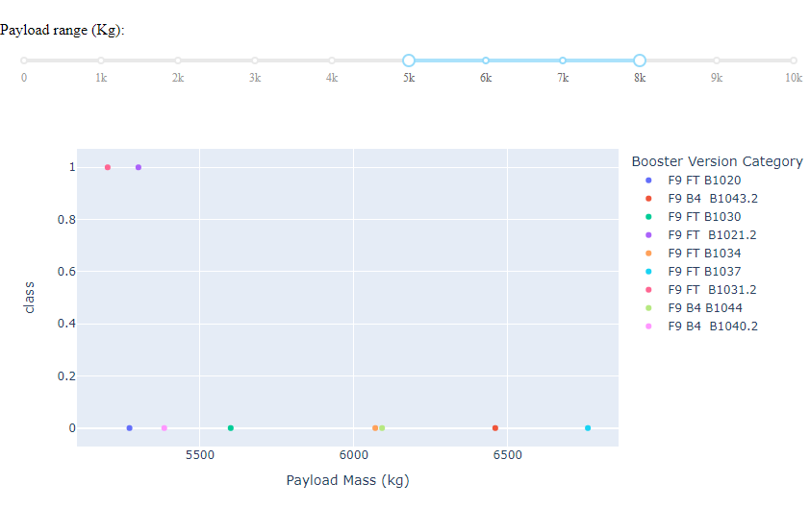
Dashboard – All launch sites
Show relation of site, booster version and success/fail
Show success by site

Slide 15
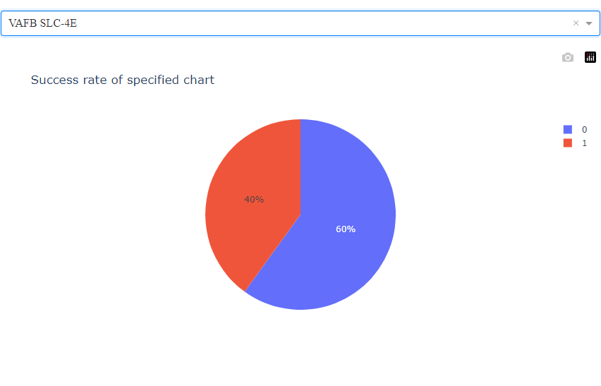
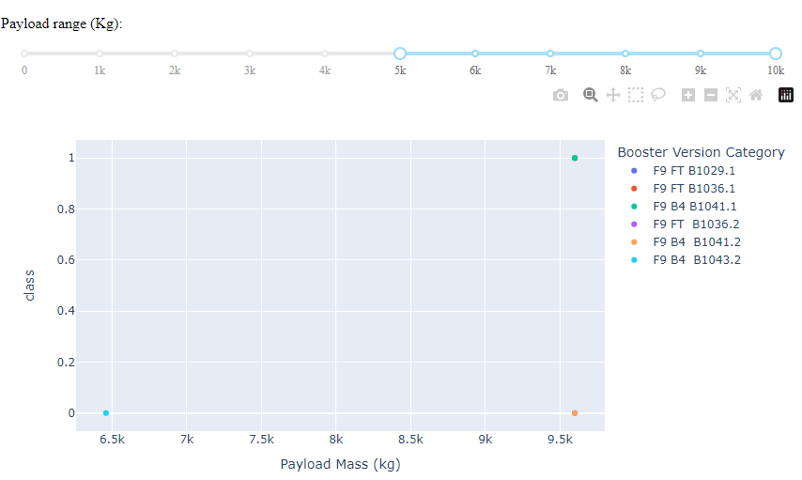
Dashboard – Single site
Show relation of chosen site, booster version and success/fail
Success/fail chart

Slide 16
DISCUSSION

Slide 17
Summary of findings & implications
Major Findings
Newer flights have higher success
Few binary variables (e.g. legs, grid fins) have correlation with success rate
Few categorical variables (landing site, orbit) have correlation with success rate
Implications
While simple ML model may not be enough, it seems feasible to create an ML classifier with sufficient precision using multiple variables

Slide 18
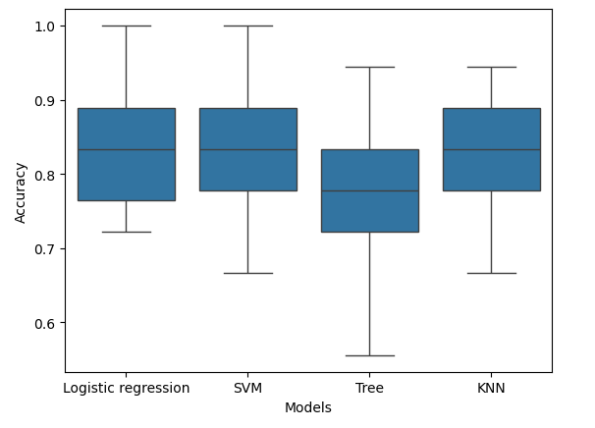
ML Classifier
Best model had accuracy of ~83%
SVM (sigmoid)
Tested 20 iterations of random sampling test set
Confidence Interval (95.0%): (0.79, 0.880)
Caveat: Logistic regression, SVM, KNN accuracies are quite similar. Better to tune when there's more data available.

Slide 19
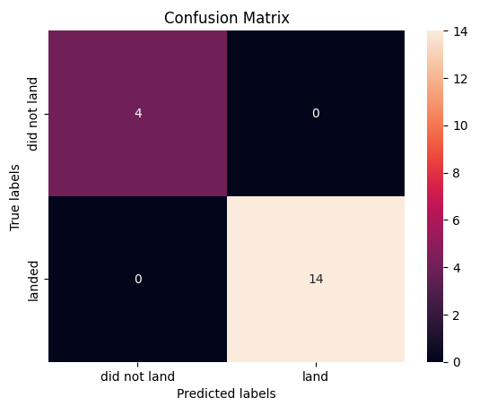
ML Classifier
Best test sample for SVM had 100% accuracy!!!
...however, the sample size is quite small

Slide 20
OVERALL FINDINGS & IMPLICATIONS
Findings
With feature engineering, best suited model (SVM) had average accuracy of 83%
Other model accuracies were quite close
Test (and train) sample size is small
Implications
We can likely increase the accuracy with more time
The best way to improve & evaluate the model is have more launch data points

Slide 21

CONCLUSION
To have competitive pricing when competing with SpaceX, we analyzed SpaceX launch data analysis and build classifier for its launch reuse
Our best model had average accuracy of 83%
More fine tuning can be done, however best way to improve will be to have more data points

Slide 22

APPENDIX

Slide 23
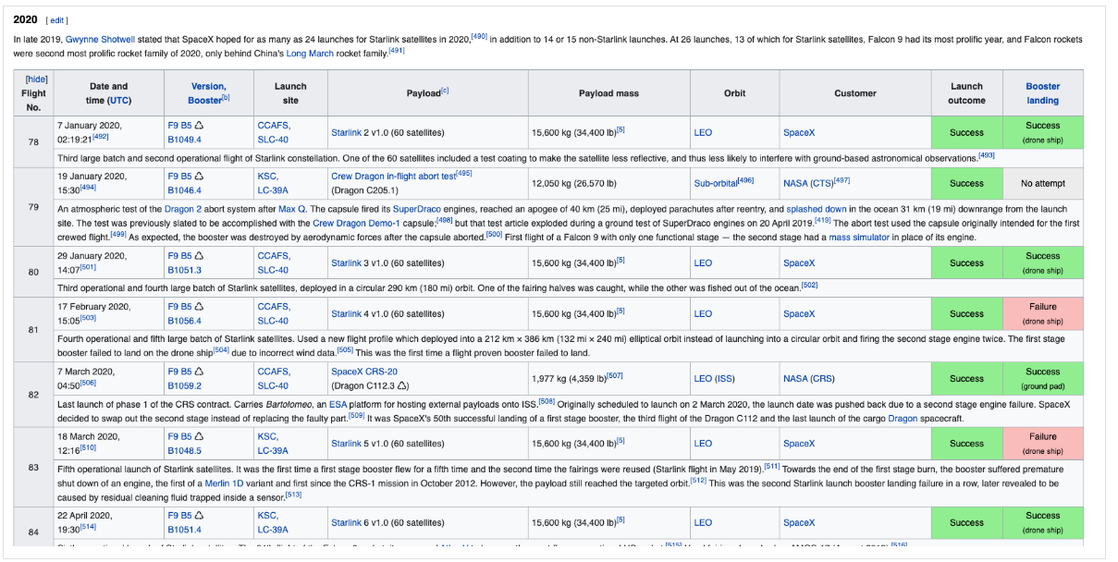
Data scraped from wikipedia

Slide 24
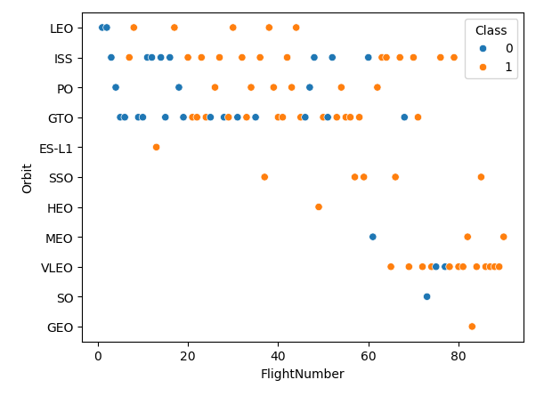
Comparing orbit type, flight # and success/fail

Slide 25
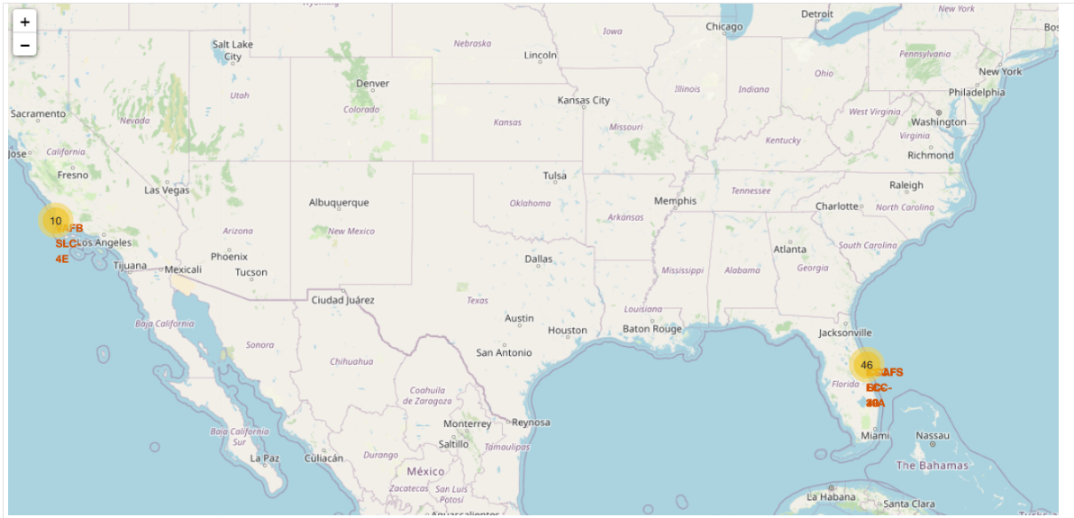
Space X launch locations

